Slide 1

A study of car accidents in the City of Chicago to derive patterns and trends from the data so as to improve on safety on the roads.
BOB OKEYO

Slide 2
OBJECTIVEs
Improving road safety standards within the city of Chicago
Derive and be aware of patterns from car accidents
Learning from data so as to understand and predict the primary contributory cause of car accidents

Slide 3
DATASET
Traffic_Crashes_-_Crashes
Traffic_Crashes_-_Vehicle
Traffic_Crashes_-_People

Slide 4
DATA PREPARATION
Reading of the CSV files
Checked for missing values
Inspected the three datasets for common columns so as to merge the datasets
Dropped columns not relevant for our analysis
Dropped rows with missing values per column
Removed duplicates
Converting datetime objects
Performed One-Hot encoding on categorical for modelling

Slide 5
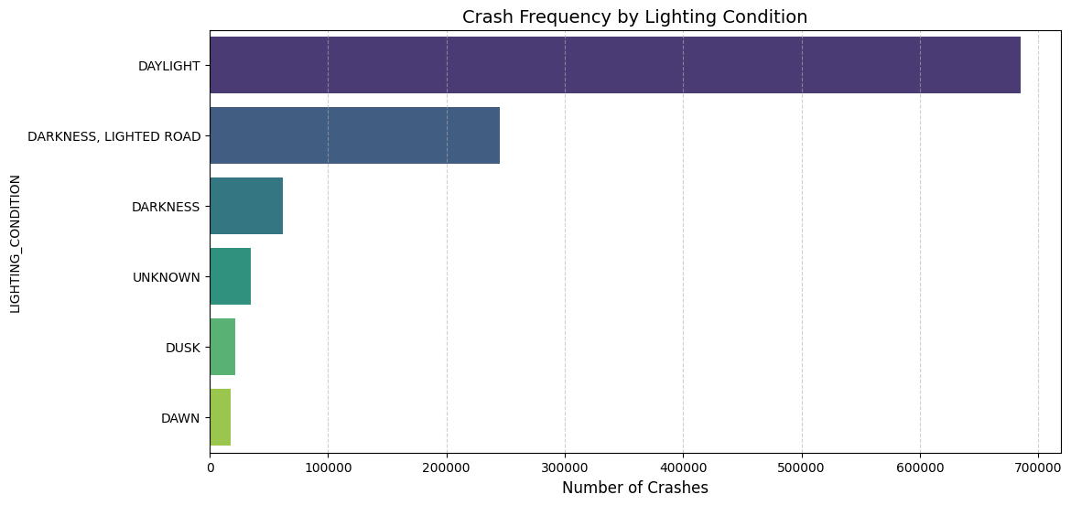
CRASH FREQUENCY BY LIGHTING CONDITION

Slide 6
CRASH FREQUENCY BY LIGHTING CONDITION
We can deduce from the bar plot above that most crashes happen during the day, this could also be explained by the number of cars on the road during the day are more than cars during the night
Car accidents during the night come a distant second and third, the difference being lighted roads and non-lighted roads respectively. We will perform further analysis in subsequent pages to understand this.

Slide 7
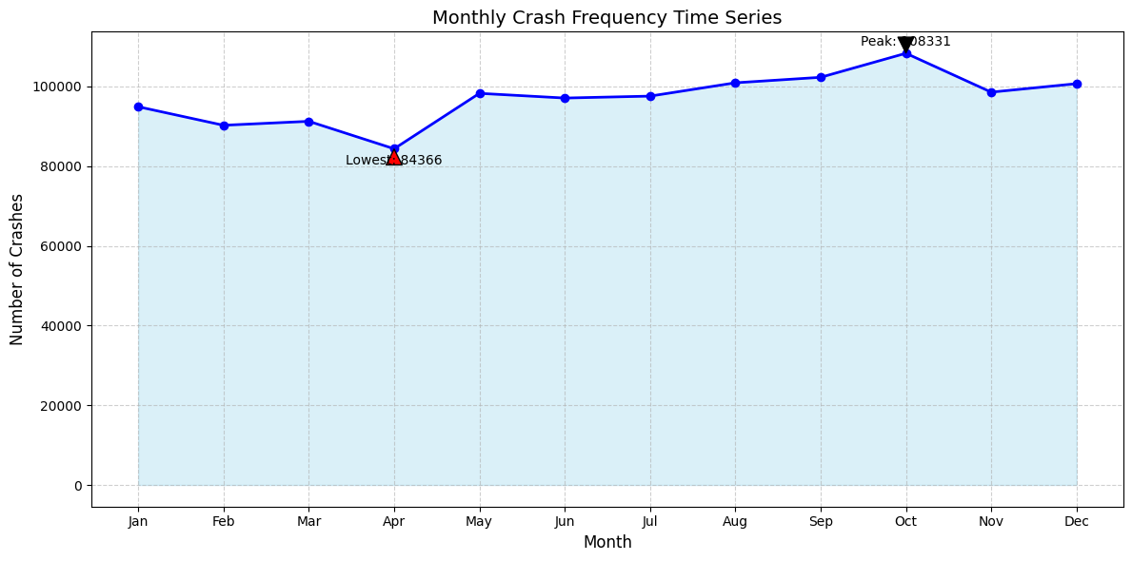
MONTHLY CRASH FREQUENCY TIME SERIES

Slide 8
Monthly crash frequency series
I performed a time series to find out how car accidents are distributed within a year. From the chart above we see that the month of October records the highest number and the month of April recording the lowest.
As we proceed, a sharp rise in accident rates can be seen from its lowest in April and can be seen to be relatively constant all through to December. This can be attributed to the weather conditions, with Chicago typically experiencing its rainiest months in May - June and snow conditions from November through March.

Slide 9
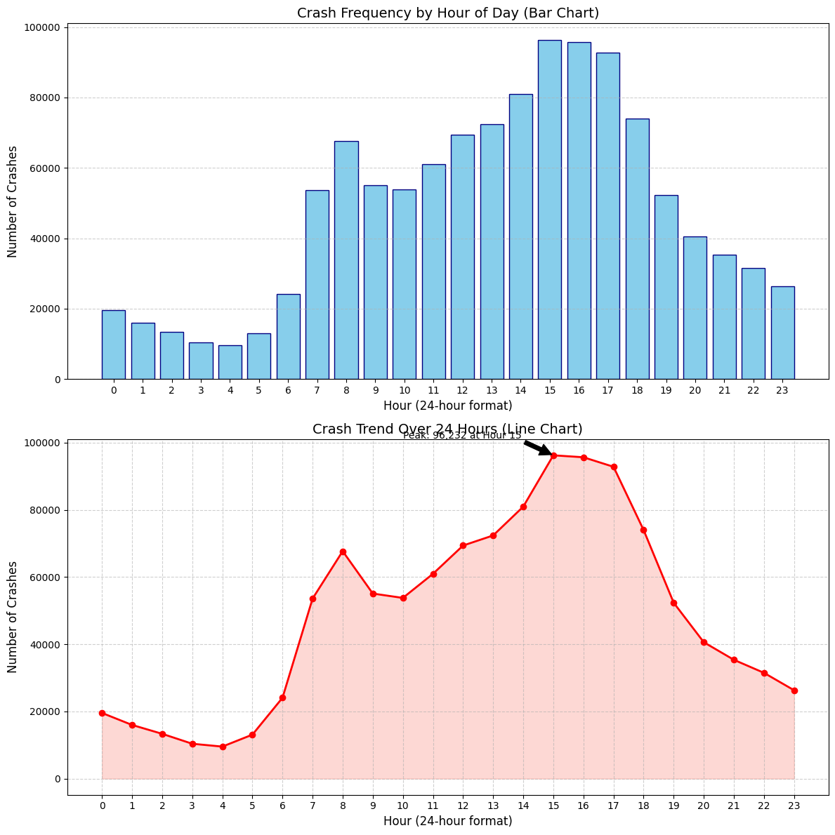
CRASH TREND BY THE HOUR

Slide 10
CRASH FREQUENCY BY THE HOUR
We can see from the bar and line graph that the highest accidents are recorded between 2pm and 5pm with over 80,000 cases by the hour. This can be attributed to driver action as we will see later on in our analysis.
Followed by 8am and 6pm at over 60,000 cases by the hour. This can be attributed to rush hours in the city.
This analysis highlights that the volume of traffic significantly influences the frequency of crashes, with risk increasing dramatically during peak transition times.

Slide 11
The provided distribution for CRASH_HOUR shows a clear pattern that aligns with daily commuting cycles. I have visualized this data using both a bar chart and a line chart to highlight the volume and trends.
Key Insights from Hourly Analysis:
Afternoon Peak: The most dangerous time of day is the afternoon rush hour, peaking at Hour 15 (3:00 PM) with 96,232 crashes. High volumes persist through Hour 16 (4:00 PM) and Hour 17 (5:00 PM).
Morning Rush: There is a secondary peak in the morning at Hour 8 (8:00 AM) with 67,699 crashes, coinciding with the start of the typical workday.
Lowest Frequency: The safest time on the roads appears to be the early morning, specifically Hour 4 (4:00 AM), which recorded the lowest count of 9,537 crashes.
Mid-Day Dip: There is a noticeable dip in incidents after the morning rush (around 9:00 AM–10:00 AM) before the steady climb toward the afternoon peak begins.

Slide 12
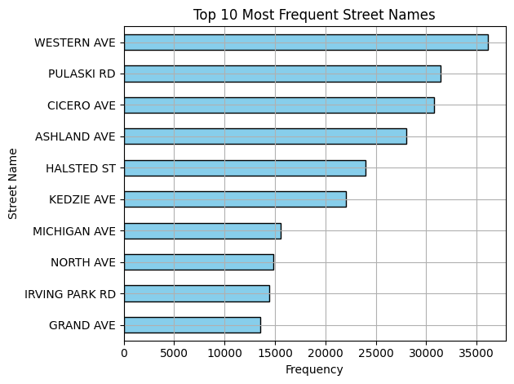
STREETS WITH HIGHEST CAR ACCIDENT RATES

Slide 13
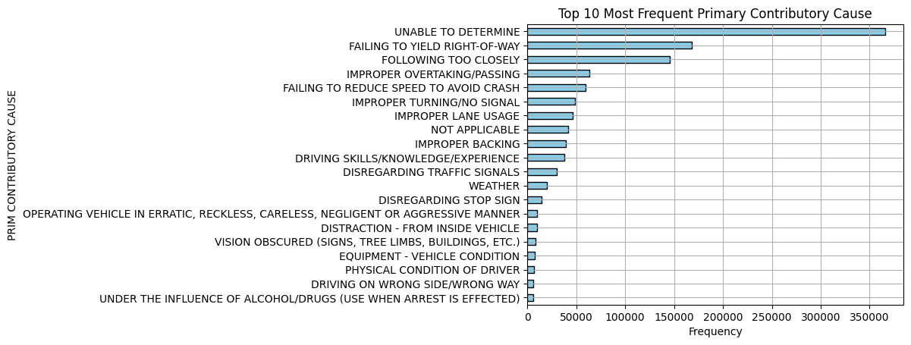
CAR ACCIDENTS PRIMARY CONTRIBUTORS

Slide 14
CAR ACCIDENTS PRIMARY CONTRIBUTORS
Based on the bar graph above, driver actions is the main contributor for car accident. Drivers failing to yield right-of-way has over 150,000 incidences, followed closely by divers following too closely.
Overall, driver actions is the main contributor to road accidents in comparison to natural factors such as weather.

Slide 15
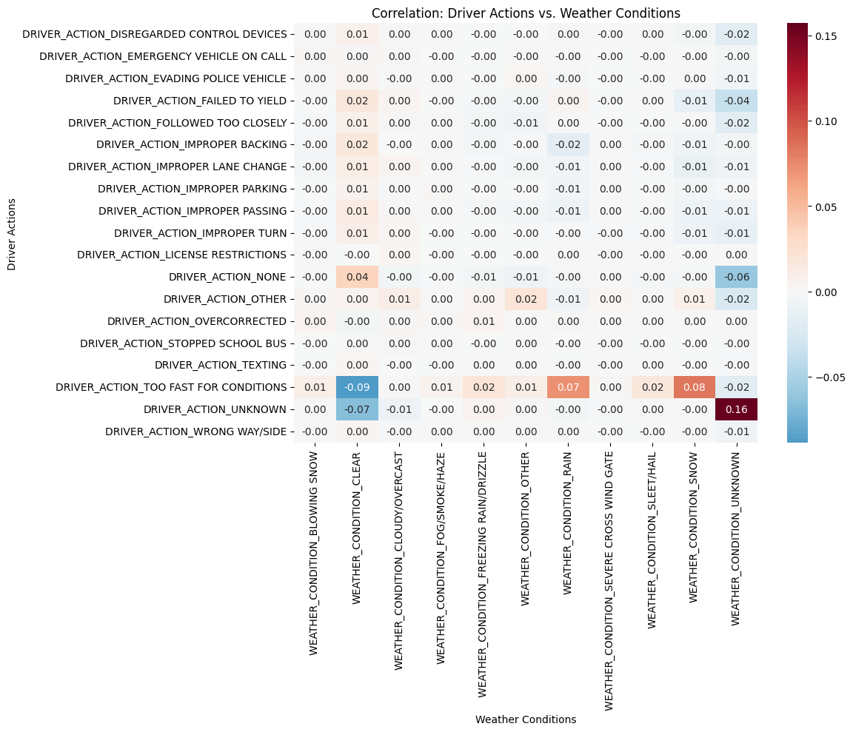
CROSS CORRELATION BETWEEN DRIVER_ACTION & WEATHER

Slide 16
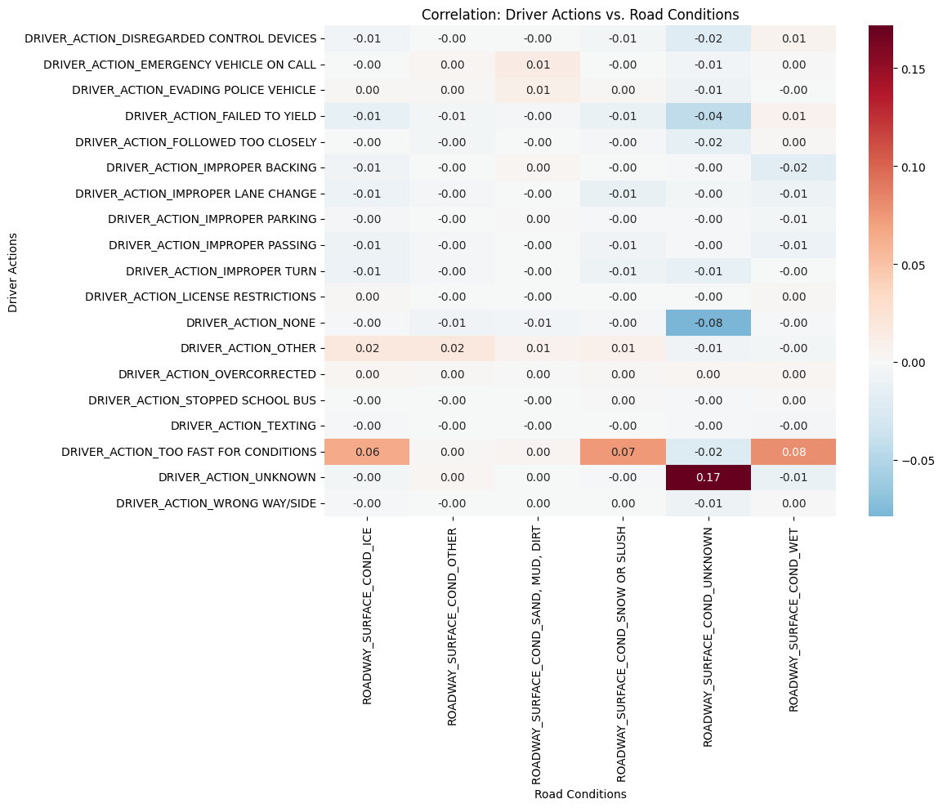
Correlation: driver actions vs roads conditions

Slide 17
CROSS CORRELATION BETWEEN DRIVER_ACTION & WEATHER
I performed a cross correlation matrix for two variables, driver action and weather to check for the relationship on a heatmap.
A strong positive relationship between driver driving too fast for conditions and rain / snowy conditions. Positive Correlation (Red/Warm): As one factor increases (e.g., Rain), the other is more likely to be present (e.g., Skidding).
Negative Correlation (Blue/Cool): We observe a strong negative relationship between clear weather conditions and driving too fast for conditions, this can be translated as If one factor is present, the other is significantly less likely.

Slide 18
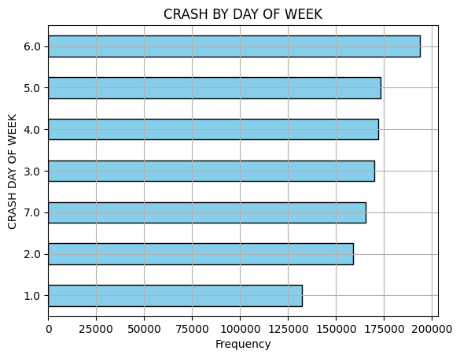
Car accidents by days of the week

Slide 19
Car accidents by days of the week
We see from the bar graph that Saturday records the highest number of accidents, followed by Friday. This trend can be attributed to Driver actions

Slide 20
1. Classification Report Heatmap
To "plot this" classification report, I have visualized the three critical dimensions of the model's performance: the Metric Heatmap, the Class Imbalance, and the Precision-Recall Conflict.
This heatmap provides a visual "report card." The warmer colors (Green) indicate where the model is succeeding, while the cooler/red colors indicate where it is failing.
Success: Aggressive/Illegal Driving and Unknown/Other show the strongest performance overall.
Failure: Distraction/Impairment and Environment/Vehicle are clearly lagging, showing low precision and F1-scores.

Slide 21
2. Class Support (The Root Cause of Inaccuracy
This bar chart "maps" the volume of data behind each category.
The Imbalance: W have roughly 14 times more data for "Aggressive/Illegal Driving" than we do for "Distraction/Impairment."
The Impact: Because the model has so few examples of distracted drivers to learn from, it is defaulting to the more common categories. This is the primary reason the overall accuracy dropped to 48%.

Slide 22
3. Precision vs. Recall Comparison
This plot highlights the "logic" of your model.
High Precision / Low Recall (Driver Error, Unknown): For these classes, the model is very conservative. It doesn't guess "Driver Error" often, but when it does, it's usually right (0.59-0.77 precision).
Low Precision / High Recall (Distraction, Environment): For these, the model is "over-guessing." It captures about 43% of the actual incidents, but it's wrong nearly 90% of the time it makes that prediction.

Slide 23
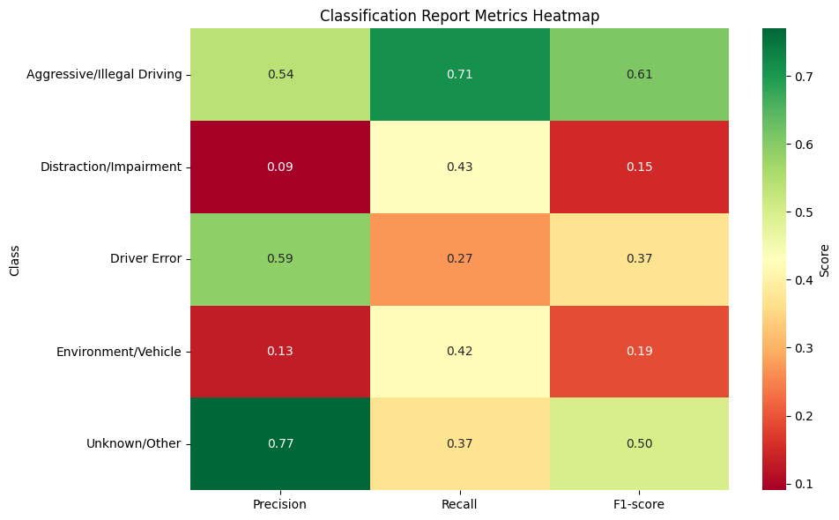

Slide 24
OBSERVATIONS
Based on my findings, here are some interesting analyses:
Crash Causes: A breakdown of the PRIM_CONTRIBUTORY_CAUSE and DRIVER_ACTION shows that driver actions is the main contributor for car accidents. Drivers failing to yield right-of-way has over 150,000 incidences, followed closely by divers following too closely.
Temporal Trends: An analysis by CRASH_HOUR, CRASH_DAY_OF_WEEK, and CRASH_MONTH reveals an interesting pattern.
From the analysis I have noted that the highest accidents are recorded between 2pm - 5pm with over 80,000 cases and 8am - 6pm at over 60,000 cases by the hour. This can be attributed to rush hours in the city. This analysis highlights that the volume of traffic significantly influences the frequency of crashes, with risk increasing dramatically during peak transition times.
Fridays and Saturdays record the highest number of accidents within a week.
The months of May through to October record the highest number of accidents.

Slide 25
RECOMMENDATIONS AND NEXT STEPS
From the trend analysis and the predictive model, we can safely predict that car accidents are likely to occur because of the actions and behavior of the driver.
Whereas weather conditions attribute to a significant number of car accidents, majority of of the cases are attributed to driver actions.
Therefore, the authorities of the city of Chicago can do the following to avert car accidents.
1. Installation of CCTV cameras on strategic intersections for recording of incidences and deterring motorists from breaking traffic rules.
2. The city of Chicago authorities has to enforce and penalize offenders to discourage breaking rules on the road.
3. Speed bumps and speed limits are recommended during rush hours and during rainy and snowy seasons of the year, frequent traffic stops on the weekends for careless driving as some of the cases could be driving under the influence of alcohol.
4. Public sensitization on road safety and traffic laws

Slide 26
BOB OKEYO
bodookeyo@gmail.com
0718880888
THANK YOU!

